Slide 1

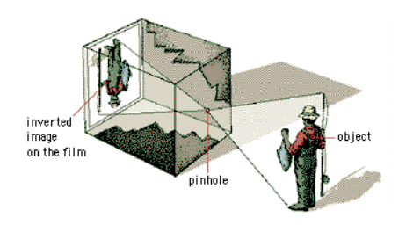
18ECE340T- MACHINE PERCEPTION WITH COGNITION
UNIT-1
S-3 Camera Models

Slide 2

Session -3
Image Models and Camera Models

Slide 3
Camera Models
Camera - one of the most essential tool in computer vision
Cameras rely on the property of light to cause hole/electron pairs in a conducting material.
When a potential is applied, this charge can be sensed as current.
(By Ohm’s law, the voltage across a resistance is proportional to the current through it, so the current can be turned into a voltage by passing it through a resistor.)
The number of hole/electron pairs is proportional to the amount of incident light.
Accordingly, greater charge and hence greater voltage and current is caused by an increase in brightness.
Cameras can provide as output, a voltage which is proportional to the brightness of the points imaged by the camera.

Slide 4
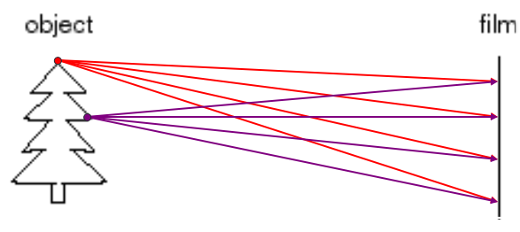
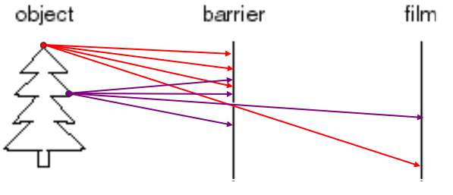
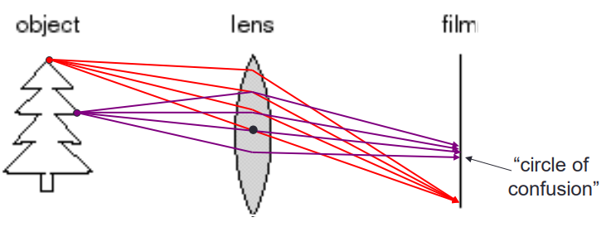
Image
Pin Hole Camera
Image Formation
Adding a Lens – Concept of Focus

Slide 5
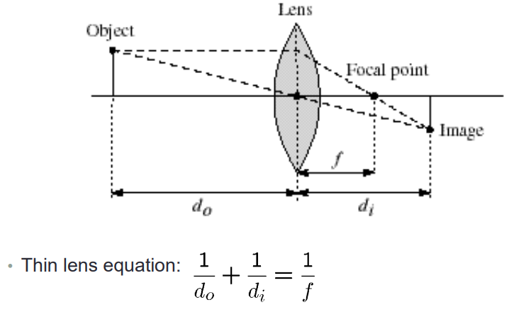
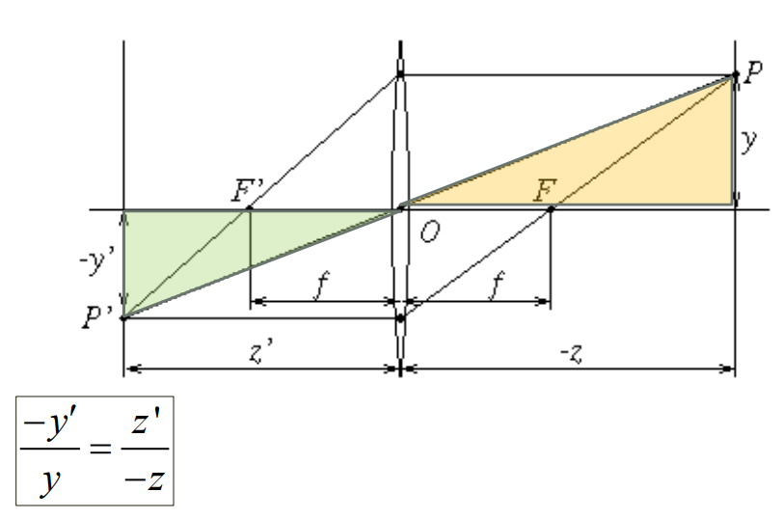
Thin Lens

Slide 6
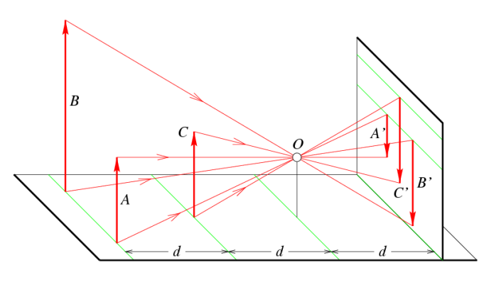
Details
Distant objects appear small

Slide 7
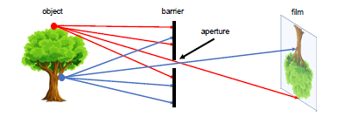
Pinhole Camera
This camera system can be designed by placing a barrier with a small aperture between the 3D object and a photographic lm or sensor.
From Figure it can be observed that, each point on the 3D object emits multiple rays of light outwards.
Without a barrier in place, every point on the lm will be influenced by light rays emitted from every point on the 3D object.
Fig: A simple working camera model: the pinhole camera model

Slide 8
Pinhole cameras
Due to the barrier, only one (or a few) of these rays of light passes through the aperture and hits the film.
Therefore, a one- to-one mapping is established between points on the 3D object and the lm.
The result is that the lm gets exposed by an “image" of the 3D object by means of this mapping.
This simple model is known as the pinhole camera model.

Slide 9
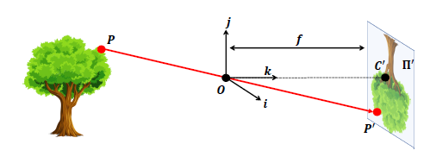
Pinhole cameras
The film is commonly called the image or retinal plane.
The aperture is referred to as the pinhole O or center of the camera.
The distance between the image plane and the pinhole O is the focal length f.
Sometimes, the retinal plane is placed between O and the 3D object at a distance f from O.
In this case, it is called the virtual image or virtual retinal plane.
Fig: A formal construction of the pinhole camera model

Slide 10
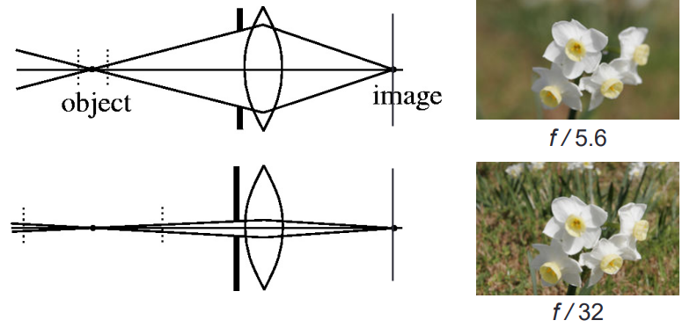
Depth of Focus
Changing the aperture size affects the depth of focus
A smaller aperture increases the range in which the object is approximately in focus
Small aperture reduces amount of light – need to increase exposure

Slide 11
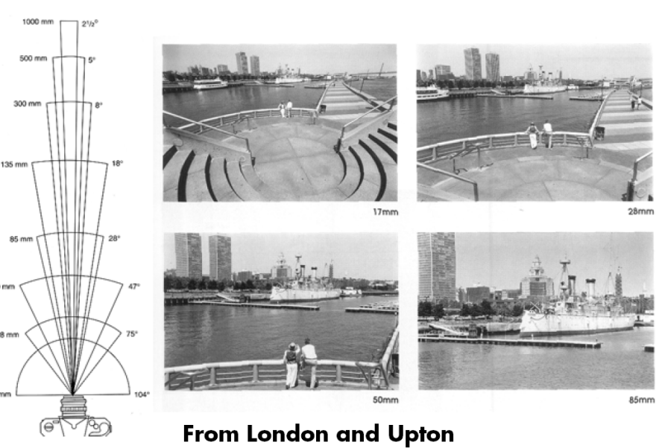
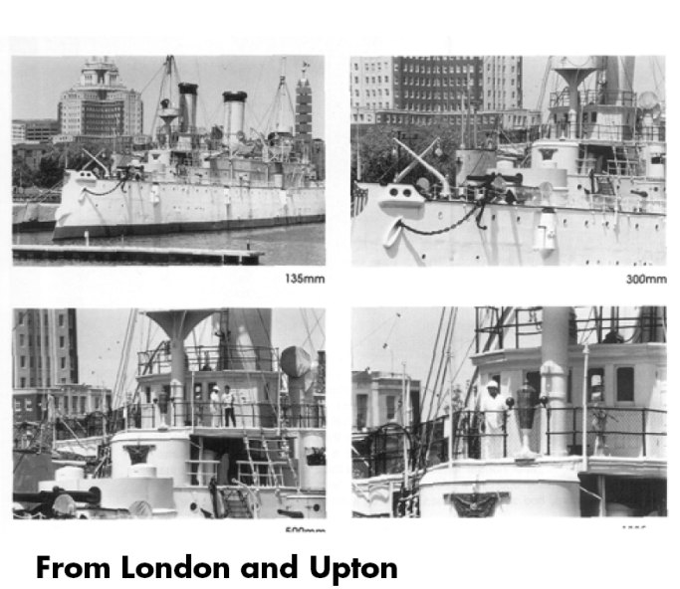
Field of View (ZOOM)

Slide 12
Field of View (ZOOM)

Slide 13
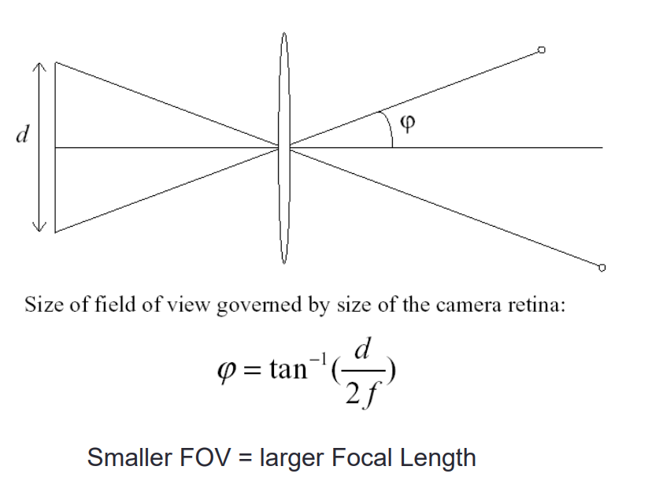
FOV depends on Focal Length

Slide 14
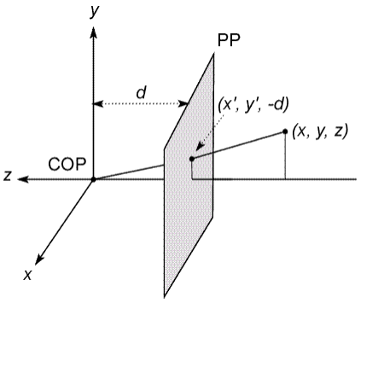
Projection Equation
COP – Center of Projection (Optical center at the origin)
Image Plane – Projection Plane
Camera looks down the negative z-axis

Slide 15
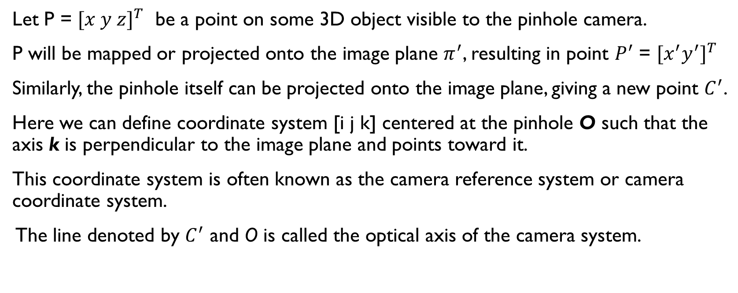
Pinhole Camera Model
Let P = ${[x y z]}^{T}$ be a point on some 3D object visible to the pinhole camera.
P will be mapped or projected onto the image plane $π^{′}$, resulting in point $P^{′}$ = ${[x^{′}y^{′}]}^{T}$
Similarly, the pinhole itself can be projected onto the image plane, giving a new point $C^{′}$.
Here we can define coordinate system [i j k] centered at the pinhole O such that the axis k is perpendicular to the image plane and points toward it.
This coordinate system is often known as the camera reference system or camera coordinate system.
The line denoted by $C^{′}$ and O is called the optical axis of the camera system.

Slide 16
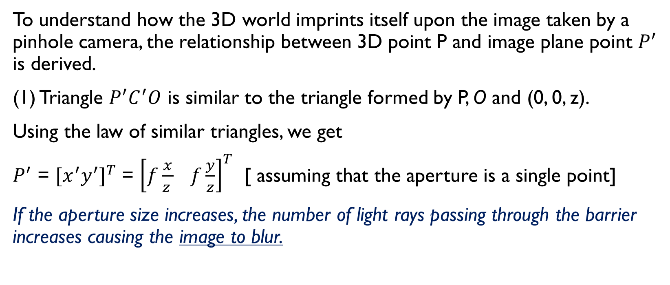
Pinhole Cameras
To understand how the 3D world imprints itself upon the image taken by a pinhole camera, the relationship between 3D point P and image plane point $P^{′}$ is derived.
(1) Triangle $P^{′}C^{′}O$ is similar to the triangle formed by P, O and (0, 0, z).
Using the law of similar triangles, we get
$P^{′}$ = ${[x^{′}y^{′}]}^{T}$ = ${\left[f\frac{x}{z } f\frac{y}{z}\right]}^{T}$ [ assuming that the aperture is a single point]
If the aperture size increases, the number of light rays passing through the barrier increases causing the image to blur.

Slide 17
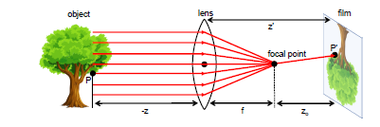
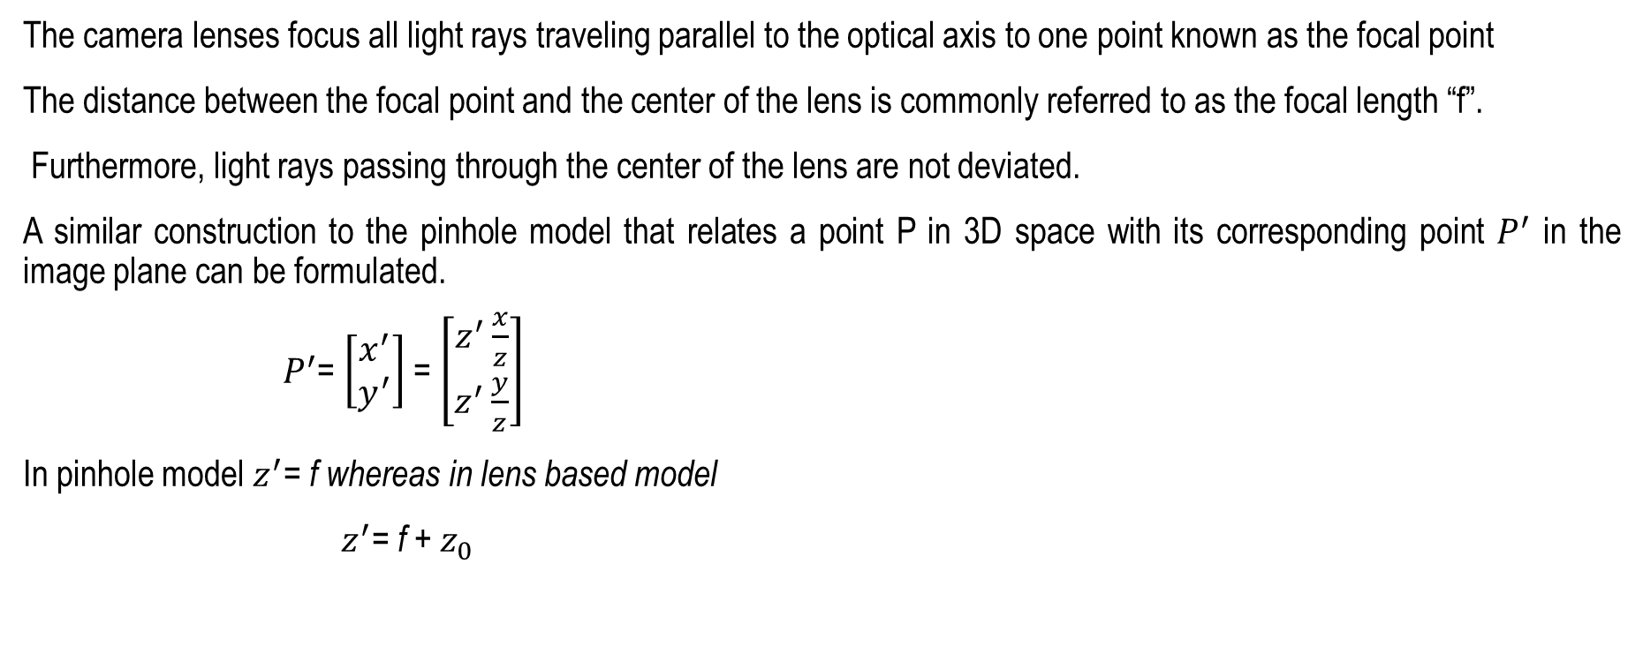
Cameras
The camera lenses focus all light rays traveling parallel to the optical axis to one point known as the focal point
The distance between the focal point and the center of the lens is commonly referred to as the focal length “f”.
Furthermore, light rays passing through the center of the lens are not deviated.
A similar construction to the pinhole model that relates a point P in 3D space with its corresponding point $P^{′}$ in the image plane can be formulated.
$P^{′}$= $\left[\begin{matrix}x^{′} \\ y^{′}\end{matrix}\right]$ = $\left[\begin{matrix}z^{′}\frac{x}{z} \\ z^{′}\frac{y}{z}\end{matrix}\right]$
In pinhole model $z^{′}$= f whereas in lens based model
${ z}^{′}$= f + $z_{0}$

Slide 18
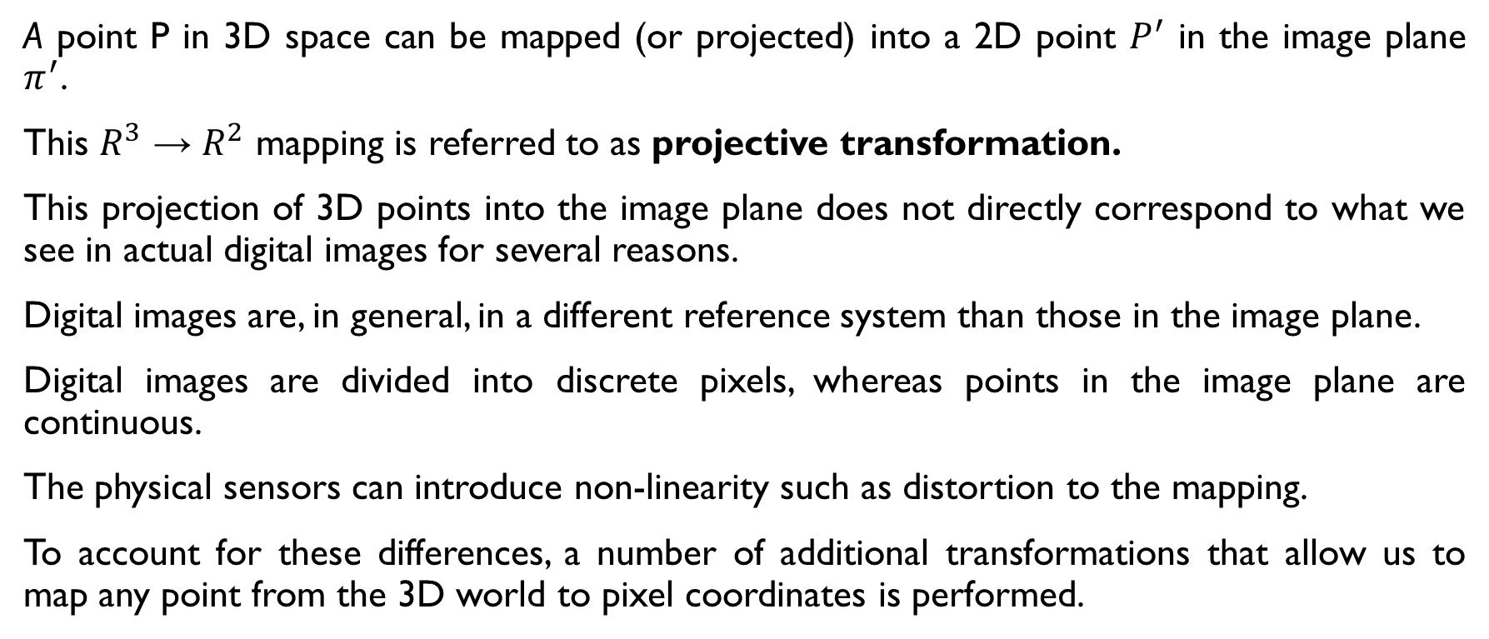
Cameras
A point P in 3D space can be mapped (or projected) into a 2D point $P^{′}$ in the image plane $π^{′}$.
This $R^{3}$ → $R^{2}$ mapping is referred to as projective transformation.
This projection of 3D points into the image plane does not directly correspond to what we see in actual digital images for several reasons.
Digital images are, in general, in a different reference system than those in the image plane.
Digital images are divided into discrete pixels, whereas points in the image plane are continuous.
The physical sensors can introduce non-linearity such as distortion to the mapping.
To account for these differences, a number of additional transformations that allow us to map any point from the 3D world to pixel coordinates is performed.

Slide 19
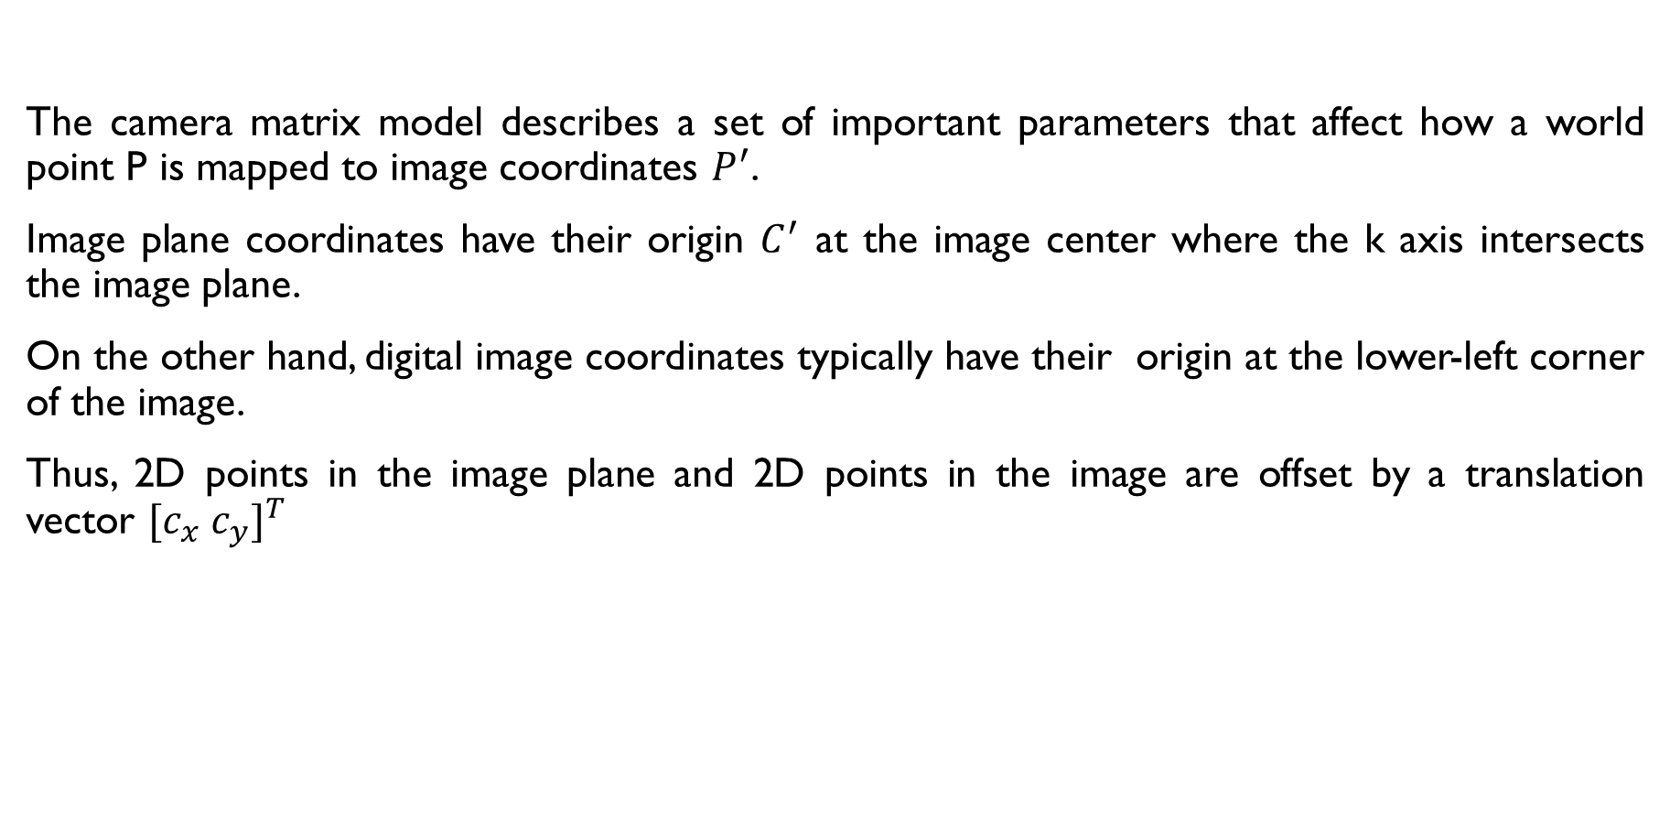
Camera Matrix Model
The camera matrix model describes a set of important parameters that affect how a world point P is mapped to image coordinates $P^{′}$.
Image plane coordinates have their origin $C^{′}$ at the image center where the k axis intersects the image plane.
On the other hand, digital image coordinates typically have their origin at the lower-left corner of the image.
Thus, 2D points in the image plane and 2D points in the image are offset by a translation vector ${[c_{x} c_{y}]}^{T}$

Slide 20
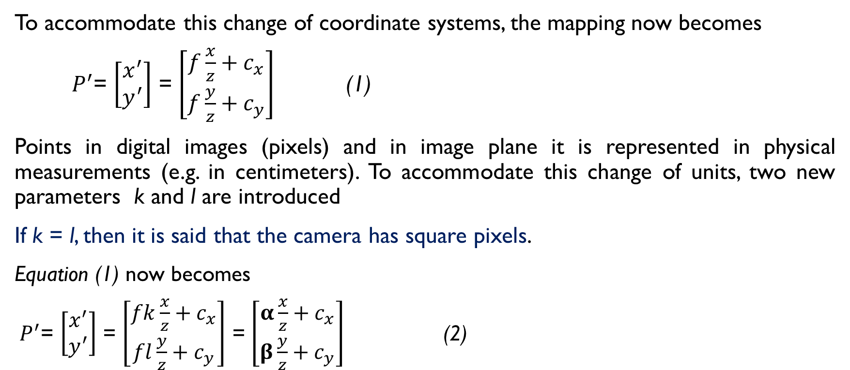
Camera Matrix Model
To accommodate this change of coordinate systems, the mapping now becomes
$P^{′}$= $\left[\begin{matrix}x^{′} \\ y^{′}\end{matrix}\right]$ = $\left[\begin{matrix}f\frac{x}{z}+c_{x} \\ f\frac{y}{z}+c_{y}\end{matrix}\right]$ (1)
Points in digital images (pixels) and in image plane it is represented in physical measurements (e.g. in centimeters). To accommodate this change of units, two new parameters k and l are introduced
If k = l, then it is said that the camera has square pixels.
$\text{Equation}\text{ (1) }\text{now} \text{becomes}$
$P^{′}$= $\left[\begin{matrix}x^{′} \\ y^{′}\end{matrix}\right]$ = $\left[\begin{matrix}fk\frac{x}{z}+c_{x} \\ fl\frac{y}{z}+c_{y}\end{matrix}\right]$ = $\left[\begin{matrix}α\frac{x}{z}+c_{x} \\ β\frac{y}{z}+c_{y}\end{matrix}\right]$ (2)
This projection is not linear and hence. cannot be represented as a product of a matrix and the input vector

Slide 21
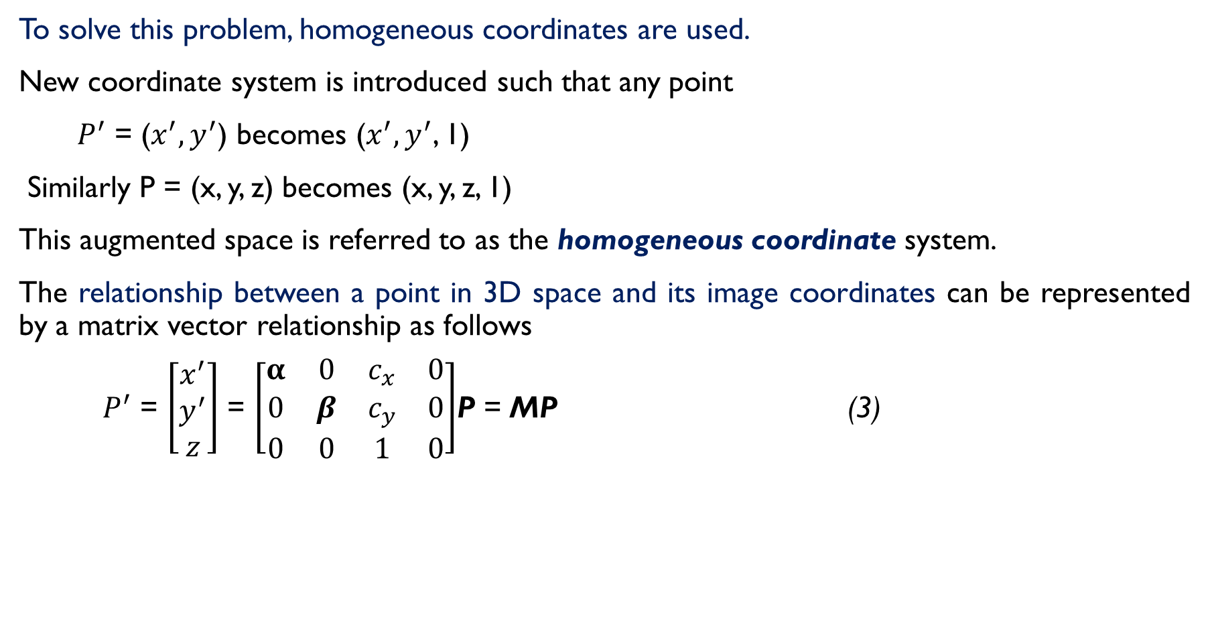
Homogeneous Coordinates
To solve this problem, homogeneous coordinates are used.
New coordinate system is introduced such that any point
$P^{′}$ = ($x^{′}, y^{′}$) becomes ($x^{′}, y^{′}$, 1)
Similarly P = (x, y, z) becomes (x, y, z, 1)
This augmented space is referred to as the homogeneous coordinate system.
The relationship between a point in 3D space and its image coordinates can be represented by a matrix vector relationship as follows
$P^{′}$ = $\left[\begin{matrix}x^{′} \\ y^{′} \\ z\end{matrix}\right]$ = $\left[\begin{matrix}α & 0 & c_{x} & 0 \\ 0 & β & c_{y} & 0 \\ 0 & 0 & 1 & 0\end{matrix}\right]$P = MP (3)

Slide 22

Homogeneous Coordinates
This transformation can be decomposed further into
$P^{′}$ = MP = $\left[\begin{matrix}α & 0 & c_{x} \\ 0 & β & c_{y} \\ 0 & 0 & 1\end{matrix}\right]\left[\begin{matrix}I & 0\end{matrix}\right]$P (4)
= K $\left[\begin{matrix}I & 0\end{matrix}\right]$P (5)
This matrix K is known as the camera matrix

Slide 23
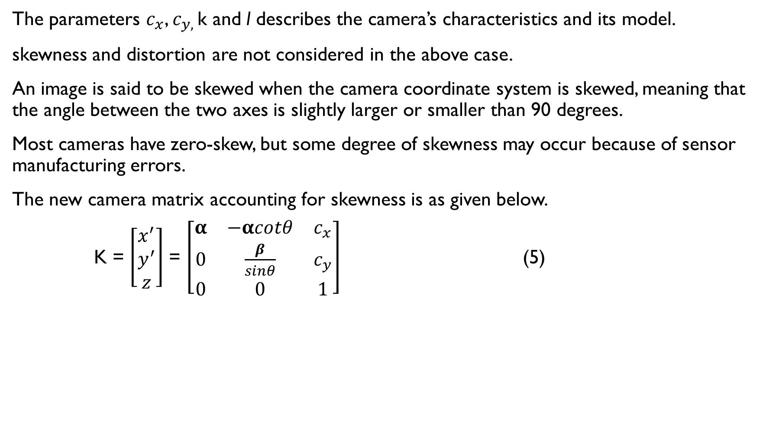
The complete camera matrix model
The parameters $c_{x}$, $c_{y, }$k and l describes the camera’s characteristics and its model.
skewness and distortion are not considered in the above case.
An image is said to be skewed when the camera coordinate system is skewed, meaning that the angle between the two axes is slightly larger or smaller than 90 degrees.
Most cameras have zero-skew, but some degree of skewness may occur because of sensor manufacturing errors.
The new camera matrix accounting for skewness is as given below.
K = $\left[\begin{matrix}x^{′} \\ y^{′} \\ z\end{matrix}\right]$ = $\left[\begin{matrix}α & −αcotθ & c_{x} \\ 0 & \frac{β}{sinθ} & c_{y} \\ 0 & 0 & 1\end{matrix}\right]$ (5)

